Slide 1

Hypernym Discovery
Team 56
Ayush Mittal - 2021201030
Aditya Gonnade - 2021202023
Swarnali Dey - 2021201088

Slide 2
Introduction to Hyponym-Hypernym Relationships
Definition
A hypernym is a broad category that includes more specific instances called hyponyms. A hyponym is a specific example or instance that falls under a broader category or class called a hypernym.
Applications
Information Retrieval, Text Classification, Semantic Analysis
Aim of the Project
Hypernym discovery aims to discover the set of hypernyms given a hyponym and corpus.

Slide 3
Scope of the Project
Given a set of input terms (concept or entity) and a vocabulary, we need to retrieve a ranked list of candidate hypernyms (up to 15) for each input term.
Approaches:
Unsupervised, supervised, and hybrid
Paper Used:
CRIM at SemEval-2018 Task 9: A Hybrid Approach to Hypernym Discovery

Slide 4
Dataset and Corpus
SemEval2018
Data File - list of hyponyms
Gold File - list of hypernyms for ith hyponym in data file
Vocabulary - contains all the words to consider for vocabulary for each corpus
UMBC Corpus
Data size of 48GB. Used subset of data to generate hypernym-hyponym patterns using Hearst pattern.

Slide 5
Hearst Patterns
Definition : The Hearst pattern is a type of linguistic pattern used to automatically extract hyponyms from text.
Example : Dogs, cats, and birds are examples of pets
Working : Defined hearst pattern using regular expression
Preprocessing : Removed punctuations, Digits
Chunking : Combined the words in the noun phrase using "_".
Pattern Matching : Match each sentence with the pattern

Slide 6
Word Embeddings
Only GloVe - Previous Approach
For the baseline approach, we used pretrained GloVe embedding.
Since GloVe embedding has no information of Hypernym Hyponym relationship and is trained on general data, we improvised our embeddings in the final model.
Pre Trained Word2Vec + further training - Final Approach
We used pre-trained word2vec embeddings. We have further trained these Word2Vec embeddings on hyponym-hypernym relationships from our dataset along with negative sampling

Slide 7
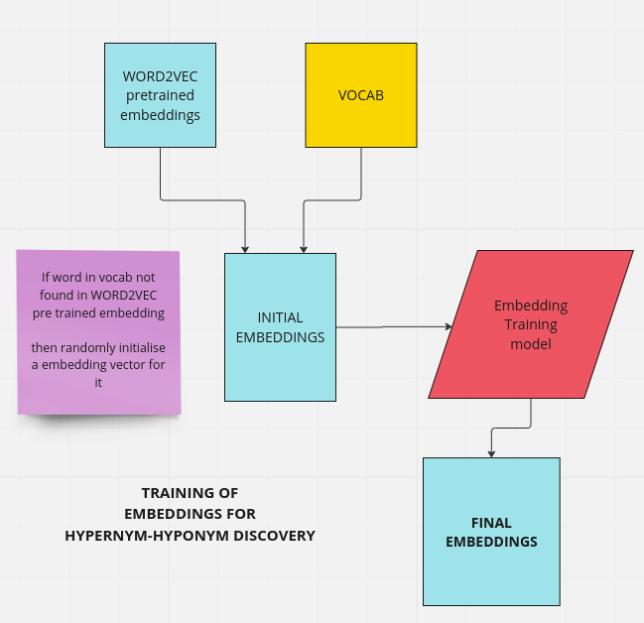

Slide 8
Training of Embedding

Slide 9
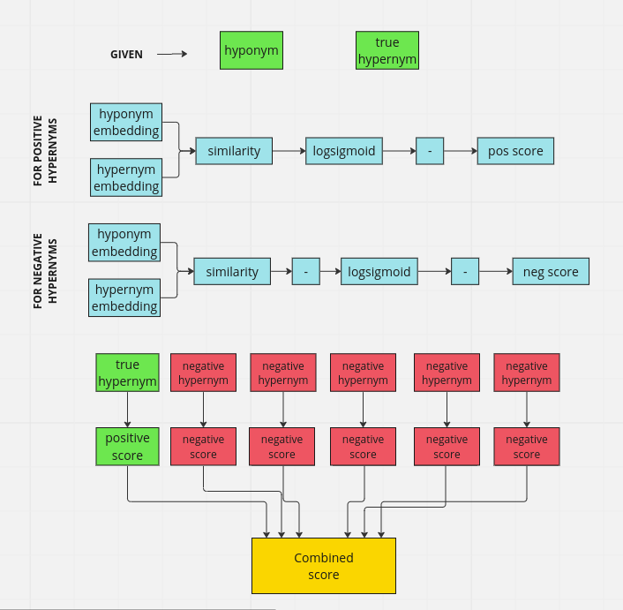

Slide 10
Some Results from Trained Embeddings

Slide 11
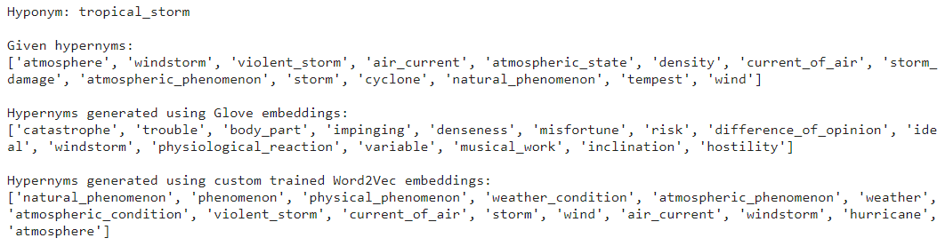

Slide 12
Unsupervised Learning Approach

Slide 13
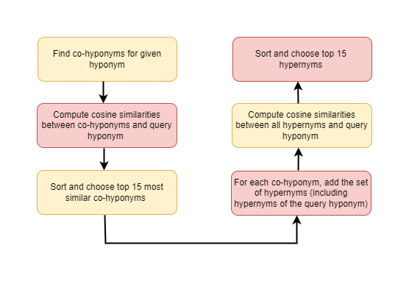

Slide 14
Supervised Approach

Slide 15
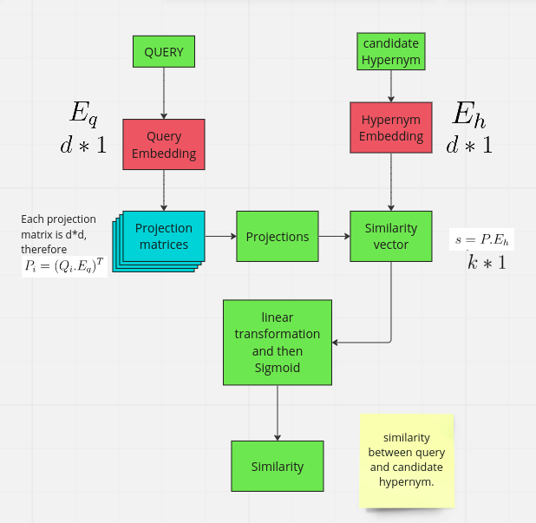

Slide 16
Target
Motive of training is to train projection matrix.
Such that the last sigmoid layer will output the similarity between hyponym and candidate hypernym.
For true pair it should be close to 1 and 0 for negative pairs.

Slide 18
Training
NEGATIVE SAMPLING - used n negative hypernyms for every true pair of hypernym-hyponym.
BINARY CLASS CLASSIFICATION - turned down the problem to 2 classes classification problem - either candidate will be hypernym or not. Hence used binary cross entropy loss.

Slide 19
Testing
For given hyponym, find similarity between each possible hypernym.
Sort similarities.
List top 100 candidate hypernyms.

Slide 20
Hybrid Approach
Supervised + unsupervised

Slide 21
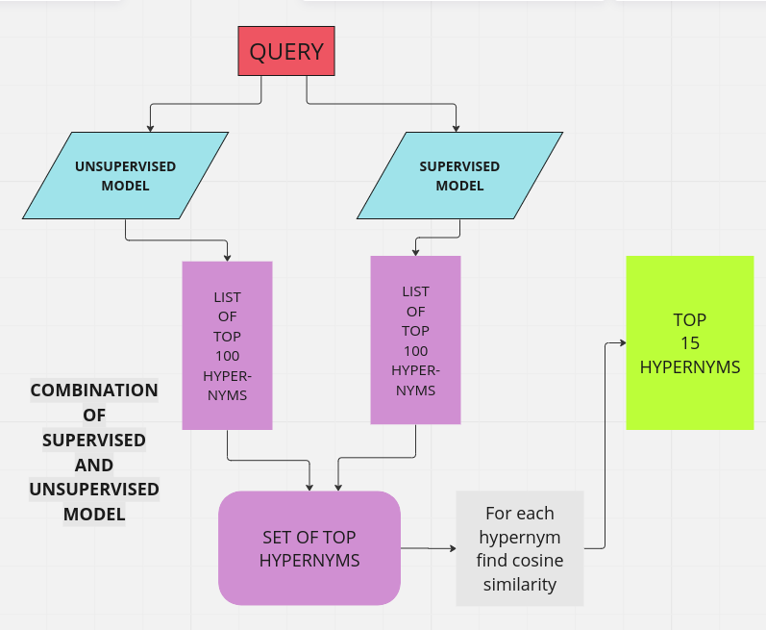

Slide 22
Analysis

Slide 23
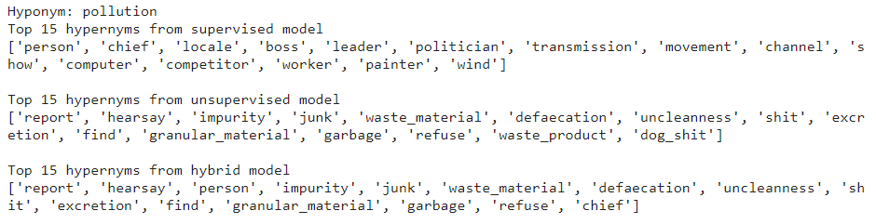
Unsupervised model works better compared to the supervised model and sometimes even better than the hybrid model. Some results are shown below.

Slide 24
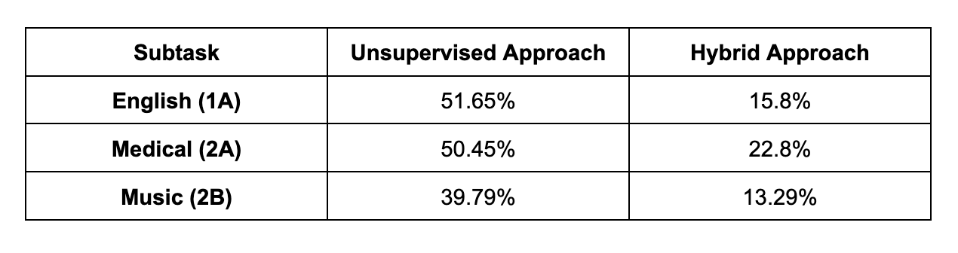
Mean Average Precision Scores

Slide 25
Thank You

